Slide 1
Teaching Computational Thinking Example: LED Strips
A Froebel Gift for the digital age

Slide 2
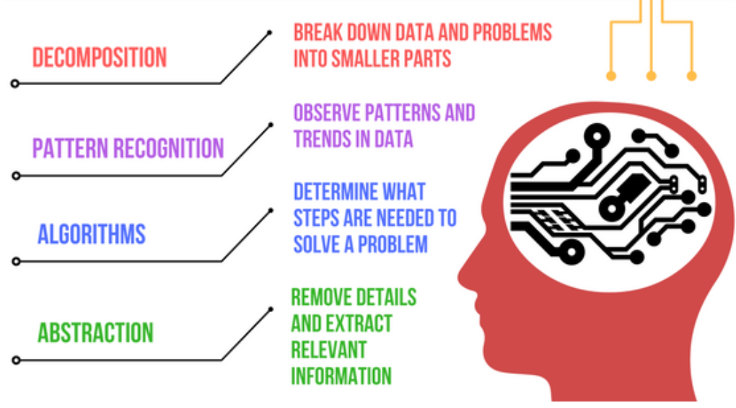
Computational Thinking
Definition: A set of problem-solving methods that involve expressing problems and their solutions in ways that a computer can execute.
https://en.wikipedia.org/wiki/Computational_thinking

Slide 3
Two Key Question
What is the simplest device that you can give a student to take home that shows their mastery of computation thinking?
What can we do to make these devices accessible to disadvantaged communities?

Slide 4
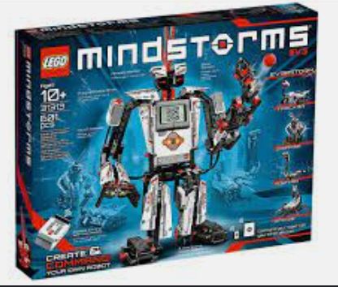
Focus on Disadvantaged Youth
There are many $400 robot kits being purchased by wealthy families with high disposable incomes
Not all schools can provide these kits to each student to take home
Can we teach computational thinking for less?
Can we cut the costs?
Can we make these kits accessible?

Slide 5
Three Dimensions of Accessibility
Low cost: target price under $20
Free curriculum that teachers can modify (Creative Commons license)
Can we show teachers, mentors and community leaders how to use these kits?

Slide 6

Social Constructionism
Students learn more when the build things with others
How can we get students to work together to solve problems without boundaries?
Break down boundaries
Other genders – boys and girls working together
Other races
Other religions
Other background
Other skills
https://en.wikipedia.org/wiki/Social_constructivism#Education

Slide 7
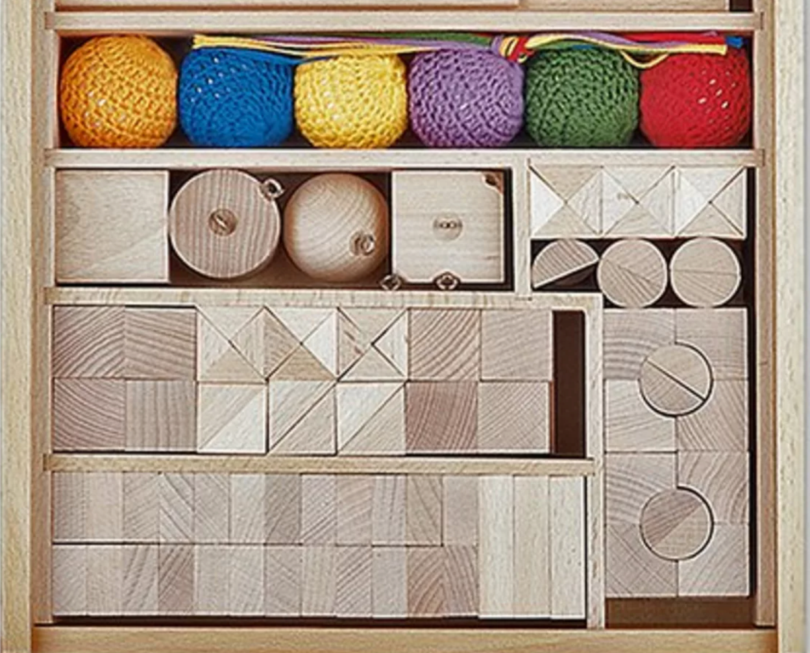
Froebel Gifts
In the 1830s, Friedrich Froebel (the inventor of Kindergarten) created as set of toys that he believed would help them learn about the world
The toys were designed from the very simple ball of wool to increasingly complex blocks with geometric shapes
https://en.wikipedia.org/wiki/Froebel_gifts

Slide 8
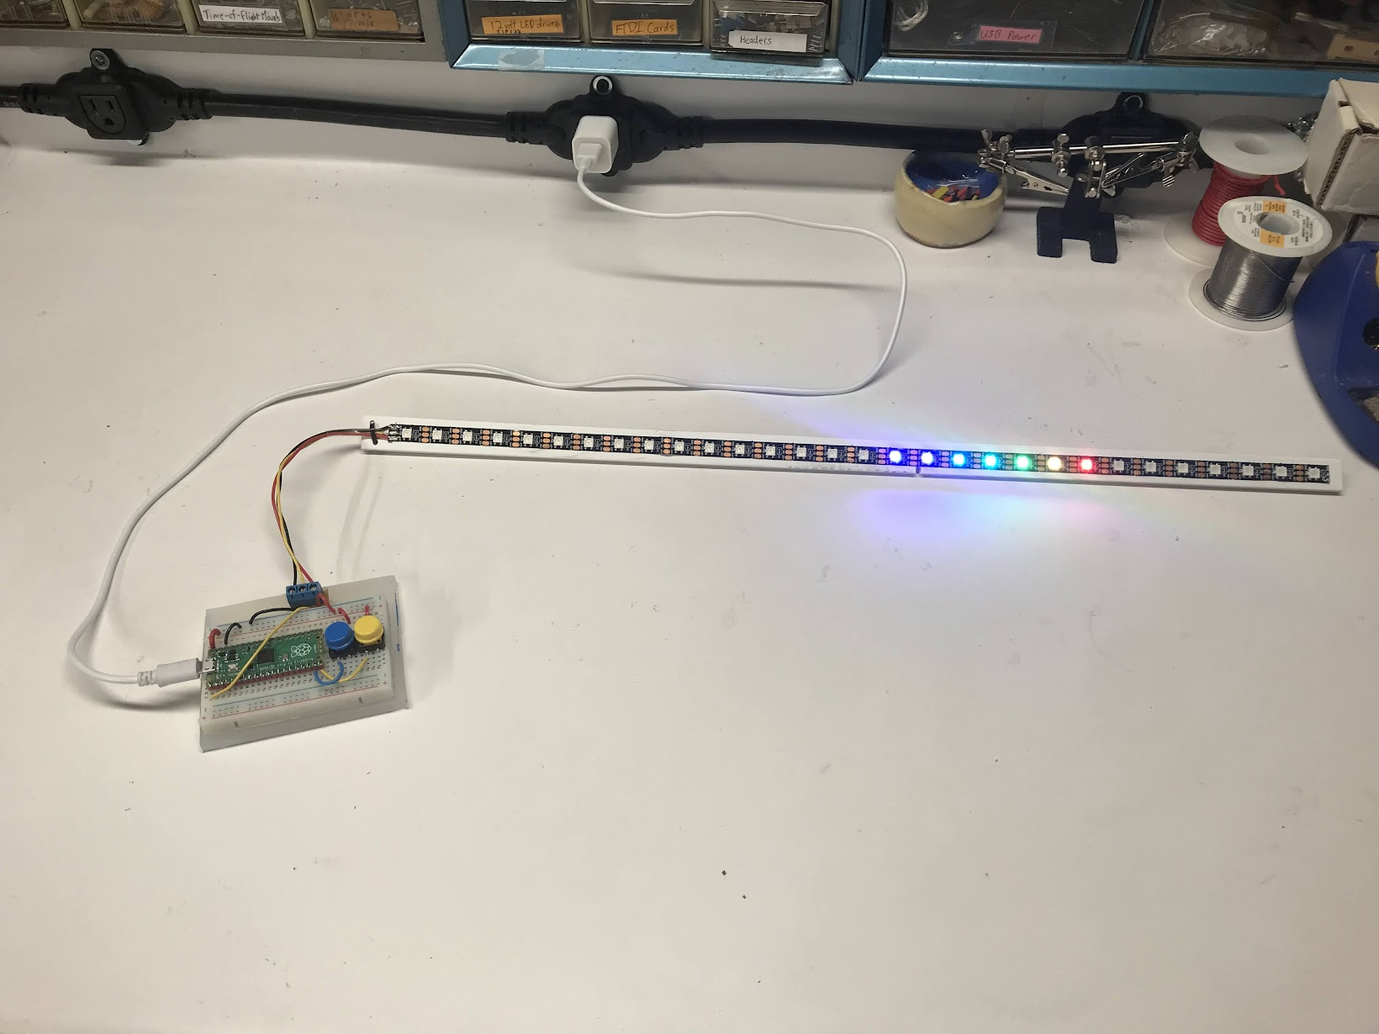
LED Strips as a Digital Froebel Gift
We have been studying interactive tools for teaching computational thinking for over ten years.
We believe that the combination of the RP2040 microcontrollers, micropython and LED strips have allowed us to create a new low-cost (under $10) toy that can be a key step in education

Slide 9

Our Journey
Dan: Teaching my three daughters about electronics taught me some important lessons
They love “hands on” learning
They love the beautiful colors of LEDs
They love taking their inventions home to show their friends!
We created kits for friends and family made from simple boxes with switches and single-color LEDs
Students loved to throw them in their backpacks and show their friends!

Slide 10
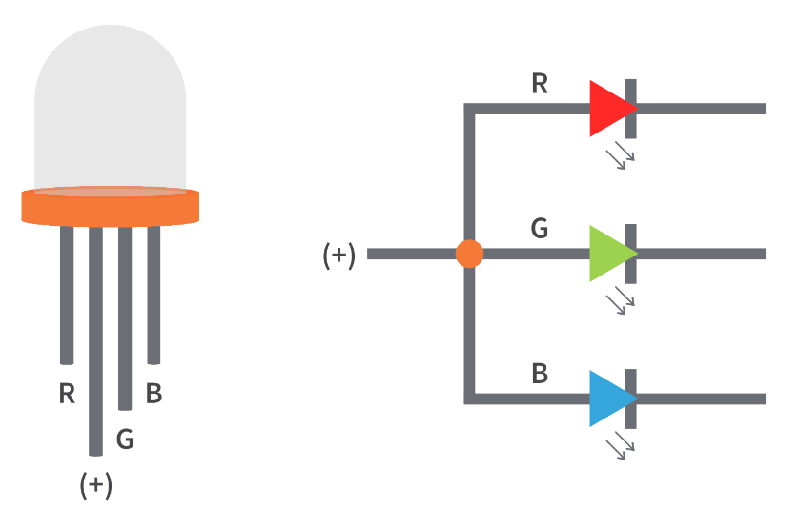
Changing Colors
LEDs with Red, Green and Blue can be mixed together to form any color of the rainbow
Four wires, three resistors – too complicated for many young students

Slide 11
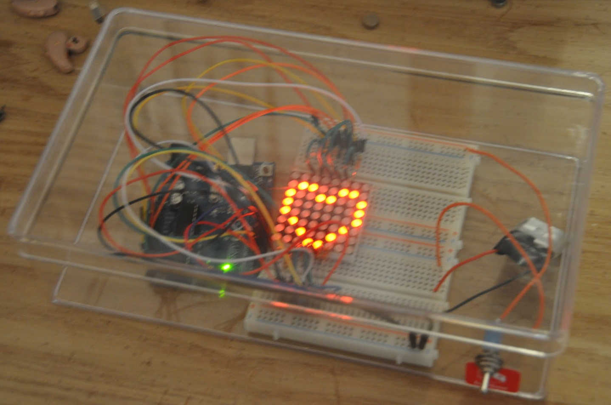
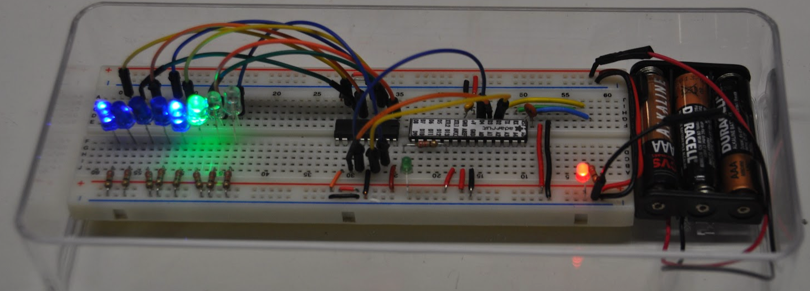
2014: Arduino
In 2014 I started to use the Arduino to control LEDs
They were expensive, hard to wire (lots of soldering) and required out students to learn C
Each RGB LED required four wires

Slide 12
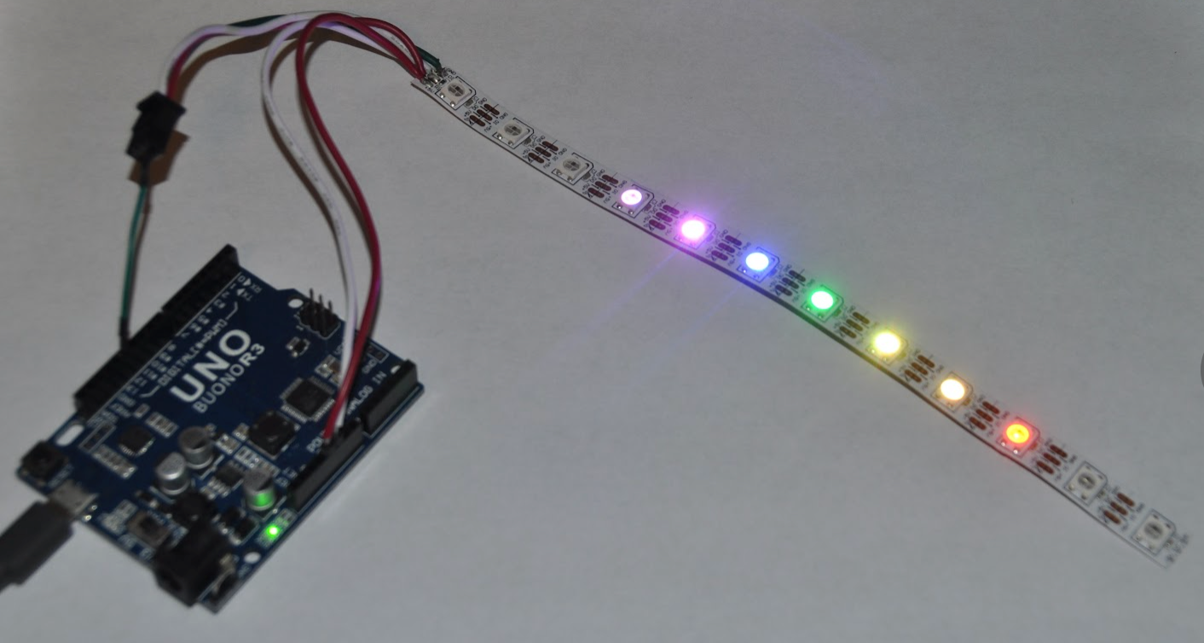
2015: LED Strips
Only three wires to connect
1 meter of 60 RGB LEDS for $25
But the Arduino Uno was still too expensive ($25)

Slide 13
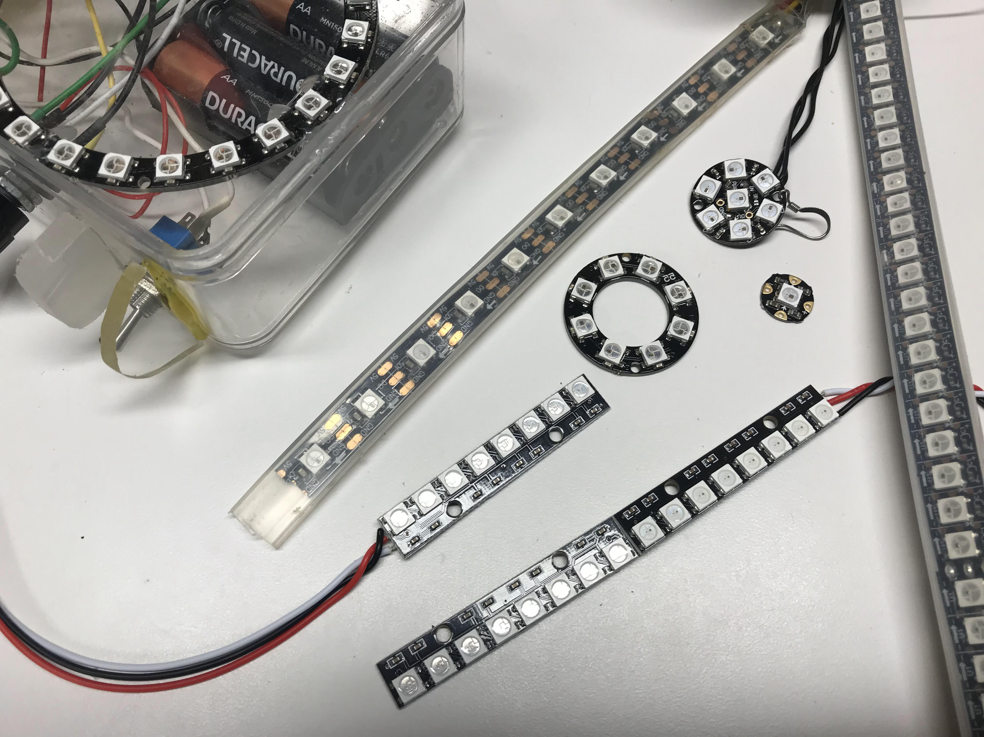
NeoPixel Rings
Many shapes and sizes
Easy to connect
Ground
Power
Data

Slide 14
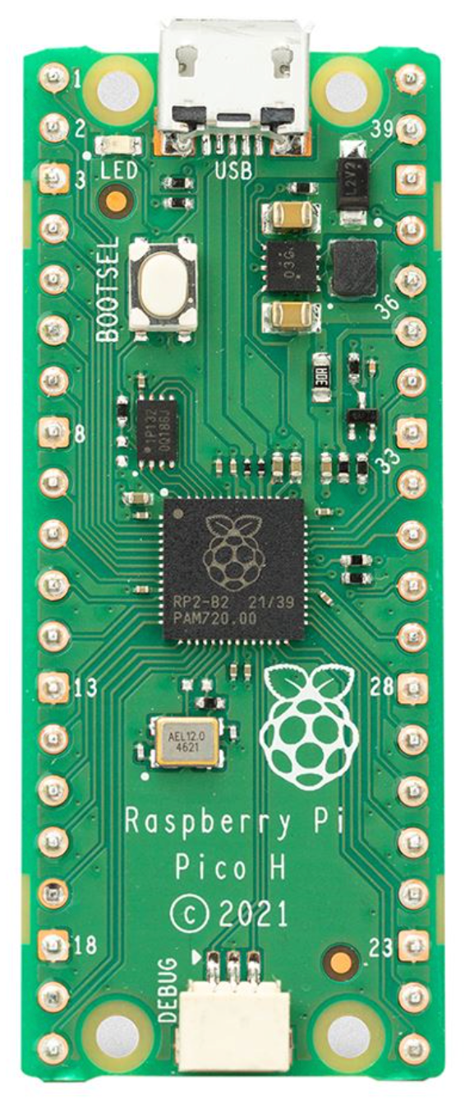
January 2021: Python comes to a $4 microcontroller!
Retail list price: $3.99!
Enough RAM to run Python and store thousands of patterns

Slide 15
The 2022 “Moving Rainbow Kit”
30 RGB LEDs
Two momentary push buttons
Thousands of patterns!
Volume prices under $10!

Slide 16
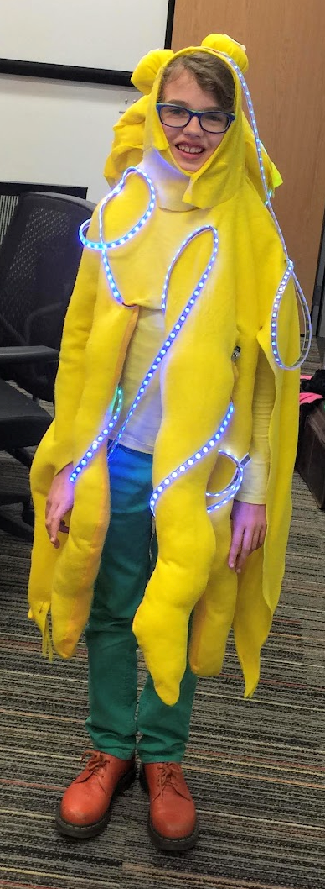
Costumes
Add bling to your
Neckless
Hats
Belts
Armbands

Slide 17
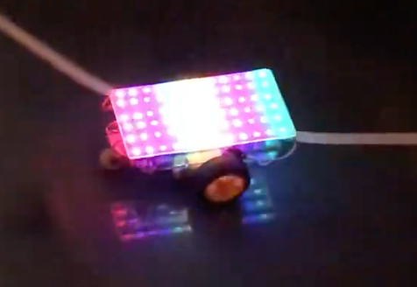
Colorful Robots
Robot with 72 RGB LEDs

Slide 18
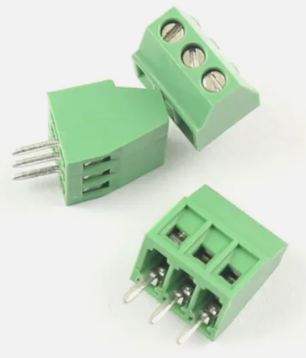
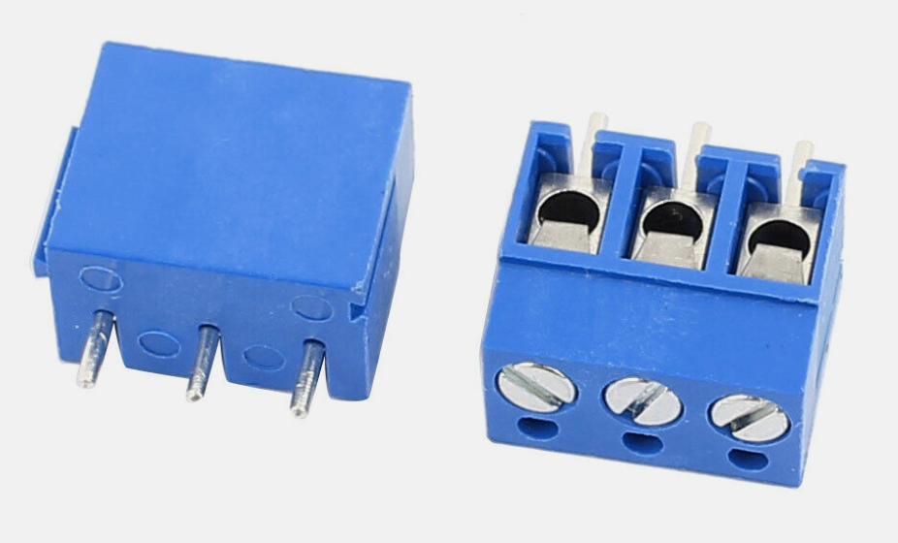
Modularity: Screw Headers
Our boards have 3-wire screw headers to allow for quick changes of the types of LED connectors

Slide 19
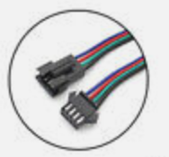

Modularity: JST Connectors
3 Pin SM JST LED Strip connectors and extension

Slide 20
Summary
We need your help!
Help us
Teach computational thinking
Promote low-cost kits
Help us build on-line content (lesson plans)
Connect us with
Schools
Coding clubs
Community centers
Libraries
Maker groups

